Slide 1

CSE 163
Introduction to Efficiency
Nicole Riley

Slide 2
Objectives
Understand the difference between timing versus steps to measure efficiency.
Why efficiency matters
Understand meaning of Big O notation.
Beginning of data structure efficiency.

Slide 3
Efficient code
Two ways to evaluate efficiency:
Speed (time)
Space (memory)
There are often trade-offs between the two of them.
We will be focusing on speed.

Slide 4
Why does this matter?
The runtime of programs seems unimportant if you think about small inputs.
But we are focused on data in this class.
If we want to start thinking about analyzing large amounts of data, we care about how fast an algorithm is.
If we choose an algorithm that is too slow, it may greatly impede the speed of our analysis.

Slide 5

Why does this matter?
https://www.digitalinformationworld.com/2018/06/infographics-data-never-sleeps-6.html Domo

Slide 6
Evaluating runtime
# assumes n is larger than 1. n is
# inclusive and an integer
def sum_of_squares(n):
total = 0
for i in range(1, n + 1):
total += i ** 2
return total
def sum_of_squares2(n):
return (n * (n + 1) * (2*n + 1)) // 6
Which one of these functions is faster? How to we measure this?

Slide 7
One way: Time
Demo
How fast do our functions run when:
n = 10
n = 1000
n = 1000000
Problems
Runtimes can vary between computers
Runtimes can vary on the same machine.

Slide 8
Method 2: Count steps
Assumption: A single simple line of code takes the same amount of time to run in Python.
Examples:
num = 5 + 10;
print(“hello);
x > 5 and x % 2 == 0
num = 5 + 10
print(“hello”)
num > 5 and num % 2 == 0
Rules:
Loop runtime is number of times it is run (N) times the number of statements
Method runtime is sum of all statements found inside of it.

Slide 9
Examples
def example_method(n):
statement1
statement2
statement3
for i in range(n):
statement4
for i in range(n):
statement5
statement6
statement7
4n + 3

Slide 10
Examples
def example_method2(n):
for i in range(n):
for j in range(n):
statement
statement
1 + n²

Slide 11
sum_of_squares
# assumes n is larger than 1. n is
# inclusive and an integer
def sum_of_squares(n):
total = 0
for i in range(1, n + 1):
total += i ** 2
return total
def sum_of_squares2(n):
return (n * (n + 1) * (2*n + 1)) // 6
n + 2
1
Two functions differ in terms of runtime by an order of magnitude (n).
How does this look as input increases in size?

Slide 12
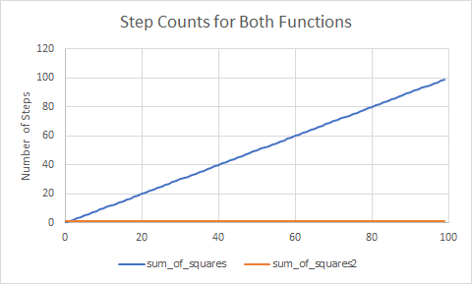
Visual

Slide 13
Growth rate
We often think of algorithms in terms of growth rate in terms of the input or input data size (n)
Think of the runtime of 5n³ + 4n² + 3n + 7.
All terms seem significant when we look at smaller inputs.
However, what happens when n becomes extremely large? At that point the term with the largest power of n will dominate (n³).
We say it runs on the order of n³ or O(n³) (Big Oh of n cubed).

Slide 14
1 min
What is the runtime of method1?
def method1(n):
value = 0
for i in range(9):
for j in range(n):
value += 7 * i + j
return value ** 2
For best results, copy from Safari with Keynote decks and from Chrome with Google Slides decks.
O(n)
O(9n + 2)
O(n²)
O(n³)
O(9n)

Slide 15
1 min
What is the runtime of method1?
def method1(n):
value = 0
for i in range(9):
for j in range(n):
value += 7 * i + j
return value ** 2
For best results, copy from Safari with Keynote decks and from Chrome with Google Slides decks.
O(n)
O(9n + 2)
O(n²)
O(n³)
O(9n)

Slide 16
Small Change
How does the runtime change with a small change?
def method1(n):
value = 0
for i in range(9):
for j in range(n):
value += 7 * i
value += j
return value ** 2
For best results, copy from Safari with Keynote decks and from Chrome with Google Slides d
Does the difference between 18n and 9n matter?

Slide 17
Coefficients
Why are constants and coefficients less important?
What is the relative difference between an algorithm with a runtime of
7n
versus
21n

Slide 18
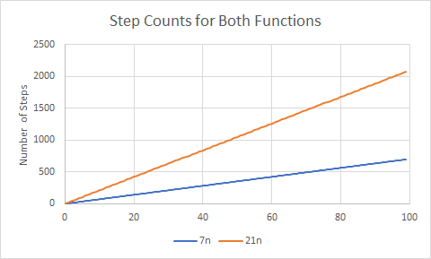
Visual

Slide 19
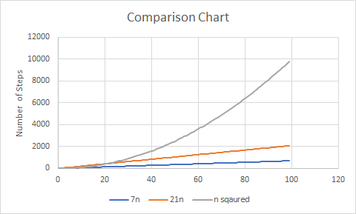
Quadratic
Comparison

Slide 20
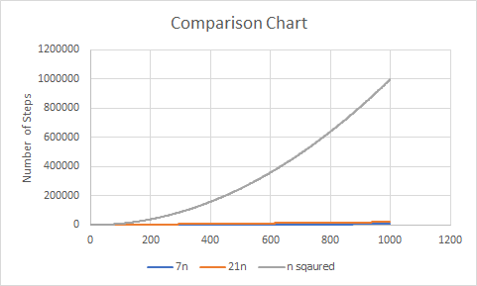
Quadratic
Comparison

Slide 21
Complexity classes
A category of algorithm efficiency based on the algorithm's relationship to the input size n
Class | Constant | If n doubles, then
Constant | O(1) | unchanged
Linear | O(n) | doubles
Quadratic | O(n²) | quadruples
Cubic | O(n³) | Multiplies by 8
...
Exponential | O(2^{n}) | Multiplies drastically

Slide 22

Complexity classes
http://recursive-design.com/blog/2010/12/07/comp-sci-101-big-o-notation/ - post about a Google interview

Slide 23

Brain Break

Slide 24
Data Structure Efficiency
Demo
Because we care about the speed our code runs, we also care about the data structures we use to complete tasks.
Today we will be focusing on two python data structures
Lists
Sets

Slide 25
List Solution
def count_unique_list(file_name):
words = list()
with open(file_name) as file:
for line in file.readlines():
for word in line.split():
if word not in words:
words.append(word)
return len(words)

Slide 26
Set Solution
def count_unique_set(file_name):
words = set()
with open(file_name) as file:
for line in file.readlines():
for word in line.split():
if word not in words:
words.add(word)
return len(words)

Slide 27
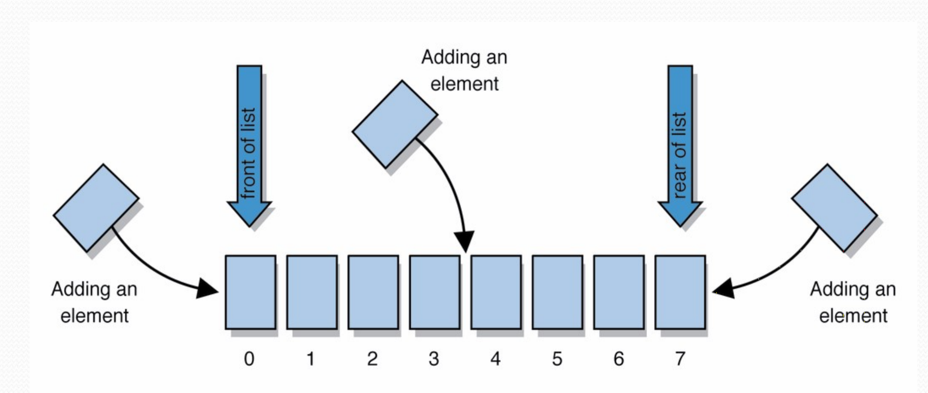
Implementing the in operator
On a high level, what do we need to do to implement in for a list?
Let’s assume list elements are stored as smaller elements in a single contiguous piece of memory

Slide 28
Implementing the in operator
How long would this operation take?
Well it depends on both the list and the word
What if we are looking for the word “I”?
What if we are looking for the word “dogs”?
What if we are looking for the word “corgi”?
We can think about our worst case input: when the word is not in the list.
list_example = [“I”, “like”, “petting”, “dogs”]

Slide 29
Difference in Efficiency
Why does a set or list make a difference in terms of efficiency?
Lists and sets serve different purposes and have different operations optimized (meant to be faster).
in operation is what makes the difference.
Searching in a list is O(n)
Searching in a set is O(1)
Adding operation to the end of a list or a set is O(1)
list_example = [“I”, “like”, “petting”, “dogs”]
set_example = {“I”, “like”, “petting”, “dogs”}

Slide 30
1 min
What is the runtime of method2?
def method2(n):
lst = [];
for i in range(n):
lst.append([j ** 2 for j in range(n) if j % 2 == 0])
return lst
O(n)
O(1)
O(n²)
O(n³)
O(2n²)

Slide 31
1 min
What is the runtime of method2?
def method2(n):
lst = [];
for i in range(n):
lst.append([j ** 2 for j in range(n) if j % 2 == 0])
return lst
O(n)
O(1)
O(n²)
O(n³)
O(2n²)

